Slide 1
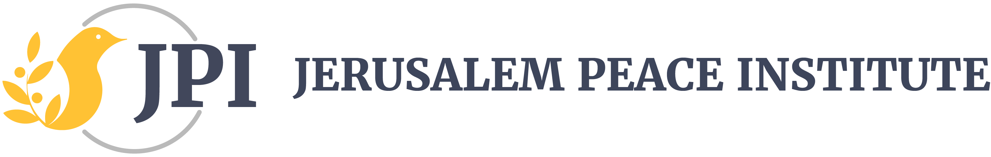
JERUSALEM—A LIVING MOSAIC
This PowerPoint relates to the essay under the Jerusalem Insights at https://www.jerusalem-pi.org/category/jerusalem-insights/
Saliba Sarsar, Ph.D.
President & CEO
Jerusalem Peace Institute
Not for publication, posting online, or distribution in any format

Slide 2
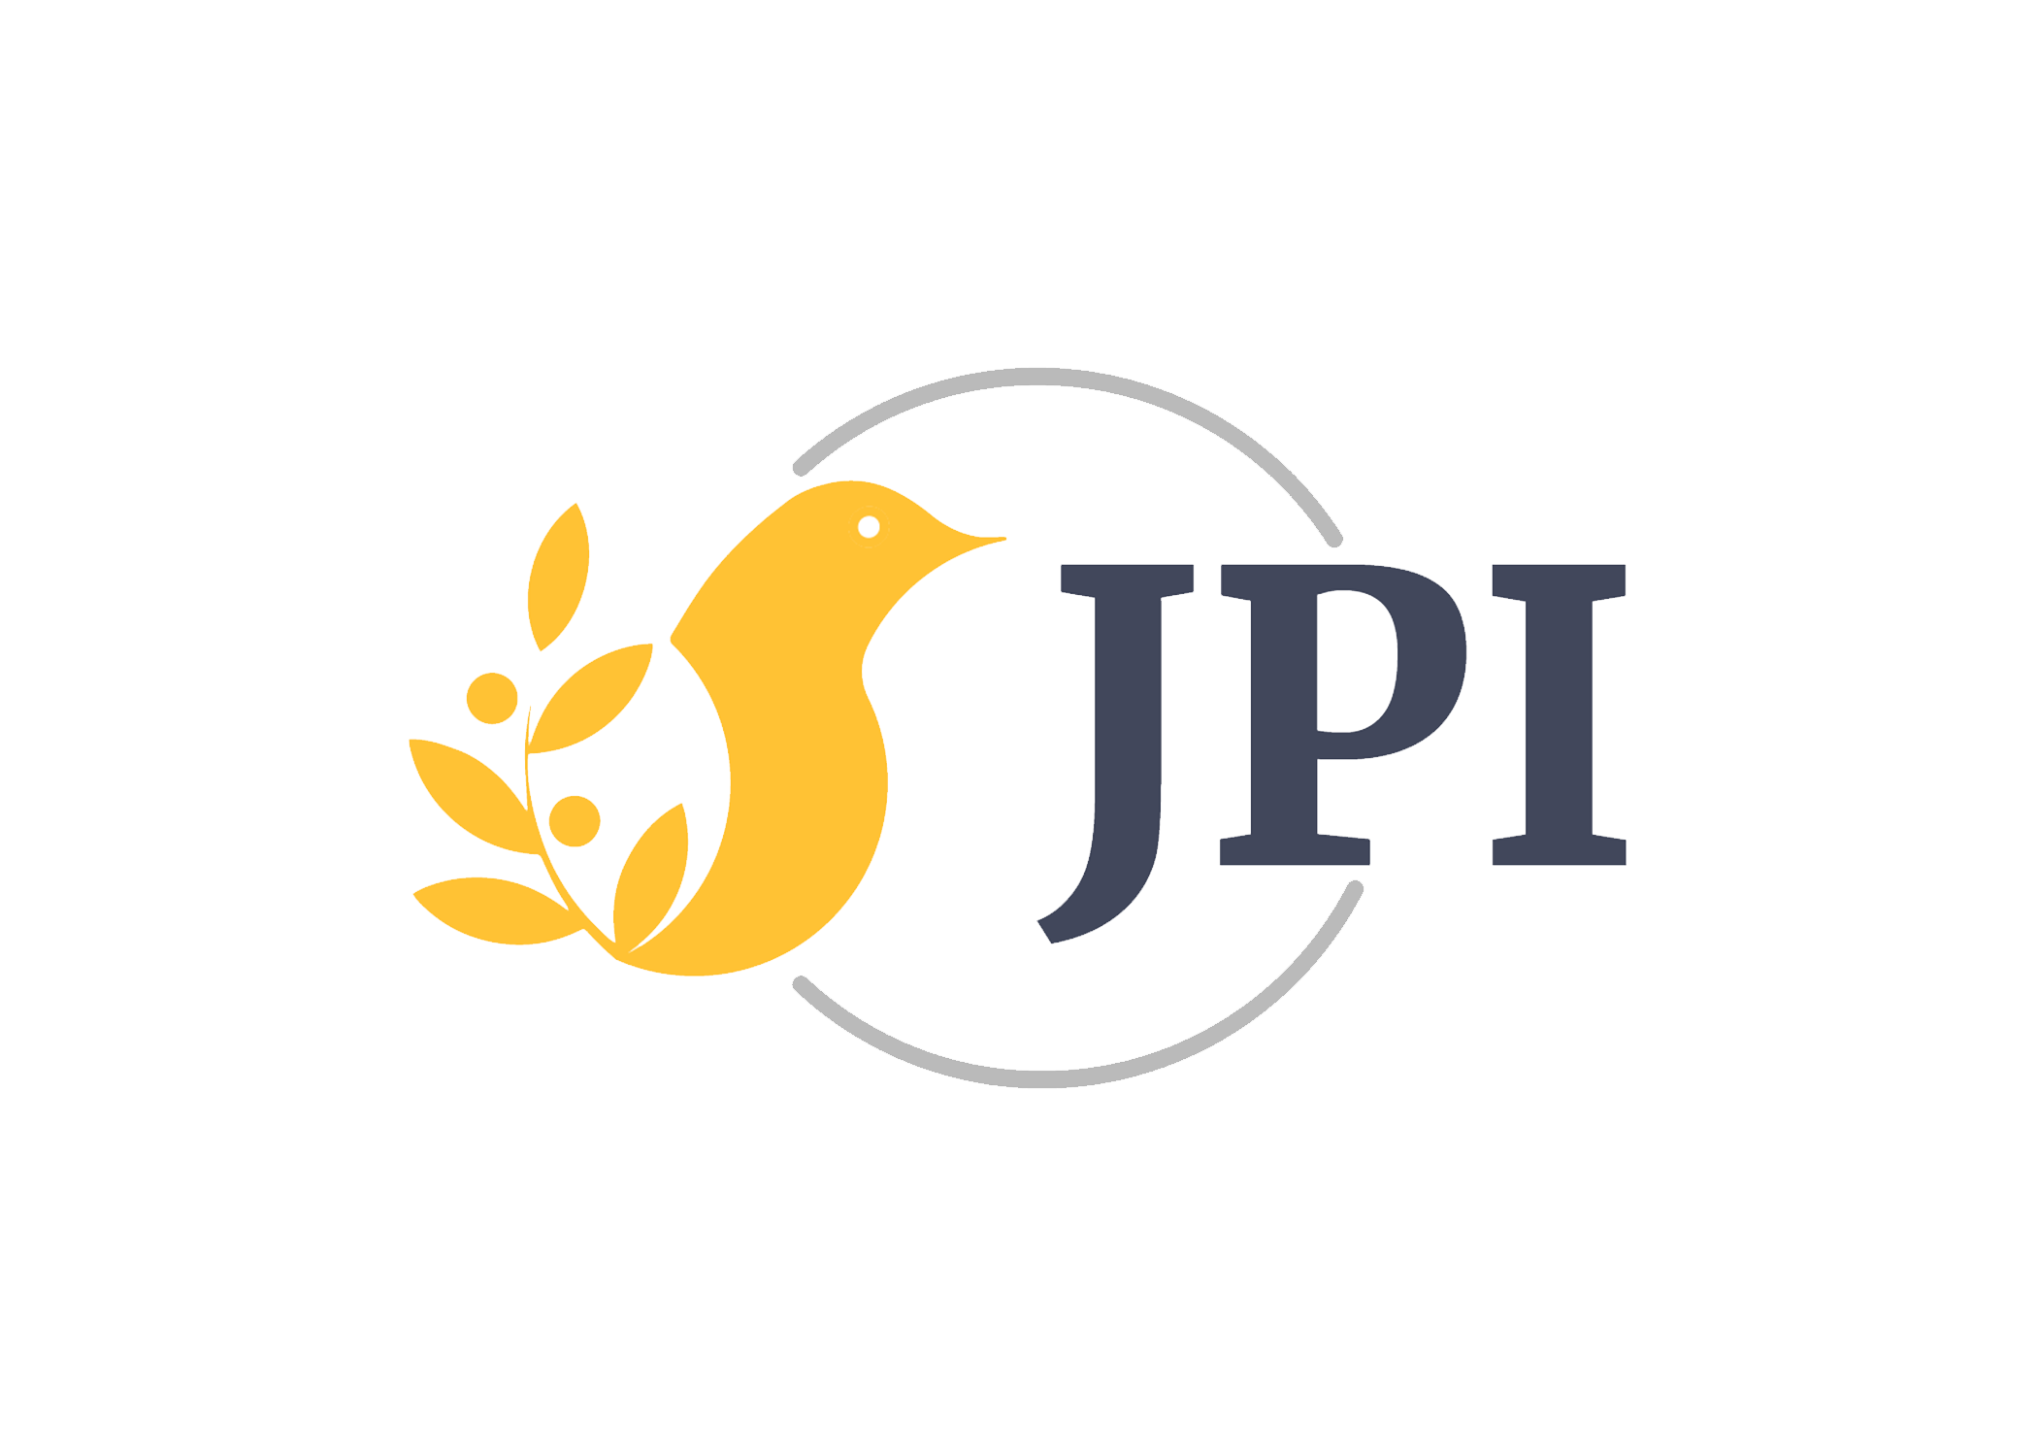
Jerusalem … A Living Mosaic
Spiritual Place
Religious Space
Historical Intersection
Political Domain
Cultural Milieu
Home

Slide 3
Jerusalem as Spiritual Place …
Jerusalem is imprinted in our being, in our hearts. It is the center of our existence and our destiny.
Multitudes of people experience this same reality. In Jerusalem, we are home. We sense better and more connections than anywhere else. We feel that the earth is nearer to the Heavens.
Jerusalem is a monument in its own right. Churches, mosques, synagogues, the Old City wall (with its eight enormous gates, seven of which are open), museums, the landscapes, and the identities and interests they all represent, imbue her with sacred narratives.

Slide 4
… Jerusalem as Spiritual Place
Long-time Arab and Jewish residents; Greek and Russian pilgrims; Jewish immigrants from Europe, North Africa, and Southwest Asia; Protestant missionaries from Germany, Sweden, and the United States—have appreciated over time the real Jerusalem, but the ideal Jerusalem was equally important to them. The earthly and heavenly Jerusalem, forever intertwined, still appeal to the imagination.
Cemeteries surround parts of the Old City wall. Believers wish to live and be buried within the sight and sounds of the Divine, of Judgment Day. Members of my family are buried on the Western Hill, commonly known as Jabal Sahyoun or Mount Zion, a few feet from King David’s Tomb, the Cenacle or site of The Last Supper, and Dormition Abby where Mary, Jesus’s mother, fell into eternal sleep.
Jerusalem is not an island unto itself. It is interdependent with the region and the world. The Creator’s love and our human compassion instruct that we recognize that every community and every house of worship anywhere is ultimately Jerusalem. Jerusalem radiates light to all, but all equally nourishes its life.

Slide 5
Jerusalem as Religious Space …
Jerusalem expresses, to varying degrees, the actualities and visions of the three monotheistic faiths of Judaism, Christianity, and Islam.
Over the millennia, Jerusalem assumed importance to their “sacred geography”. As Karen Armstrong stated, “This makes it very difficult for them to see the city objectively, because [she] has become bound up with their conception of themselves and the ultimate reality—some-times called ‘God’ or the sacred—that gives our mundane life meaning and value”.

Slide 6
For Jews
Jews believe that Jerusalem is the center of their consciousness, “the house of our life”.
Symbolizing religious connectedness and national independence, her possession and safety are vital.

Slide 7
In Their Own Words
Rabbi Ed Snitkoff, Director of the Ramah Israel Seminar, lives in Jerusalem
“Remembering Jerusalem permeates Jewish belief, thought, and practice in profound and powerful ways.”
Rabbi Jonathan Romain, writer and broadcaster, is director of Maidenhead Synagogue in Berkshire, England
“Over the centuries Jerusalem has also taken on a redemptive significance, based on its root meaning – ir shalom - city of peace – with the hope that it becomes a place of harmony for all peoples and the capital of a world at one with itself.”
Raphael Jospe taught Jewish philosophy at the Open University of Israel and at Hebrew University of Jerusalem
“One who wishes to relate with respect to the religious or spiritual significance of Jerusalem in Judaism cannot, accordingly, ignore the historic and national dimensions of Jerusalem in Jewish life.”

Slide 8
For Christians
For Christians, Jerusalem is the holiest city and the center of their faith. “In Jerusalem, Christianity was born. Every Christian, every Church, was born in Jerusalem. The words of the psalm apply precisely to that spiritual but real birth and belonging: ‘Everyone was born there’” (Psalm 87:5).
Marking the location of Jesus’s crucifixion and resurrection, it is the source of inspiration for Christian salvation and identity.
Sharing Jerusalem and retaining a strong connection and influence there are essential for safeguarding the Christian holy places, interests, and presence.

Slide 9
In Their Own Words
Michel Sabbah, Roman Catholic Patriarch Emeritus of Jerusalem
  “Jerusalem is the heart and spiritual homeland of every Christian living to this day whether in Jerusalem, near it, or anywhere in the world. It is where everything began, where God sent His Eternal Word, Jesus Christ, Messiah, and Savior of all. In Jerusalem, Christianity was born. Every Christian, every Church, was born in Jerusalem. The words of the Psalm apply precisely to that spiritual, but real birth and belonging: ‘Everyone was born there’ (Ps 86:5).”
Theodosios ‘Atallah Hanna’, Archbishop of Sebastia from the Greek Orthodox Patriarchate of Jerusalem
  “I will not accept that Palestine is a religious issue or let any religion monopolize it. I have difficulties calling Jerusalem a Jewish city and reject groups who deny the rights of other citizens. Anyone claiming that the city is Jewish is not recognizing Christian or Islamic rights and that Jerusalem has attachments for all.”

Slide 10
In Their Own Words
Nora Kort, President of the Arab Orthodox Society
“Throughout its five thousand years of history, Jerusalem has continued to thrive as an important political and cultural center, and it is the centuries-long home for the three monotheistic religions. This city has withstood many wars and conflicts, but despite many turbulent events, it has retained a peaceful image of unity and sacredness.”
  “Those ruling Jerusalem have employed continuous and well-planned strategies of territorial, demographic, religious, and property claims in order to maintain control over the city’s sovereignty. This is what is happening today under the Israeli occupation of Jerusalem and the Palestinian territories.”
  “[A]s with all the dead stones, the number of the ‘living stones’ has dwindled from 20 percent in the late 1940s to less than two percent today.”

Slide 11
For Muslims
Jerusalem is Islam’s third holiest city after Mecca and Medina.
It is connected with the Prophet Muhammad’s Night Journey on al-Buraq, his celebrated steed, from Al-Masjid al-Haram in Mecca to Al-Masjid al-Aqsa in Jerusalem (Al Isra’ 17:1) and his ascension to Heaven (Mi^{c}raj).
Over the years, Jerusalem has signified communal and political independence.

Slide 12
In Their Own Words
HRH Prince El Hassan bin Talal of the Hashemite Kingdom of Jordan
“Mutual respect and peaceful coexistence are essential prerequisites for a lasting peace. The status quo is simply untenable. Jerusalem is a shared gift, not the sole property of one government or one people.”
Dr. Mustafa Abu Sway, Dean of the College of Islamic Studies at Al-Quds University in Jerusalem
“Jerusalem will continue to be coveted for its deeply rooted religious and spiritual meanings, for the archaeology and history of this Canaanite Jebusite city, and for the distinct civilizational force and cultural heritage.”
Dr. Hisham Khatib, Member of Majlis Al-Ayan, the Jordanian Senate
“Whoever controls Jerusalem, it will remain one of the most historically important cities in the world, particularly for its Muslim inhabitants and Muslims all over the world.”
Dr. Imam Imad Ad Din Ahmad, President of the Minaret of Freedom Institute and Muslim Chaplain at American University
“Jerusalem is the city of prophets and the gateway of earth to heaven.”

Slide 13
… Jerusalem as Religious Space
The sacredness of Jerusalem has amplified conflict among the three monotheistic faiths. In a poignant account of a journey through the Middle East, William Dalrymple wrote, “In Jerusalem every street corner has its own martyr or monument, saint or shrine. Its soil is drenched in blood spilt in the name of religion”.
There are Jewish-Muslim tensions over the same holy compound, called the Temple Mount by the Jews and the Noble Sanctuary by the Muslims. There are even intra-faith rivalries, as demonstrated by the occasional Christian disputes among Greek Orthodox, Latin or Roman Catholic, and Armenian clergy, over rights within the Church of the Holy Sepulchre, which have prevented the badly needed church renovations. Recent restoration work on Jesus’s tomb began in June 2016 and ended in March 2017; the last was undertaken in 1809-1810 after a major fire.
The custody of the door and the key for the Church of the Holy Sepulchre have been entrusted to two Muslim Palestinian families, Judeh and Nusseibeh, for over 770 years.

Slide 14
Jerusalem as History …
During the past 4000 years, Jerusalem’s history has been partly written in blood and fire. It still stains our house of memory. Canaanites, Jebusites, Israelites, Babylonians, Assyrians, Persians, Romans, Byzantines, Arabs, Seljuks, Crusaders, Mamluks, Ottomans, and British had walked her “holy” paths and tried to make her their home, but what remains of them are mostly archives or archeological ruins!
In 1948, Jordan became the ruling power in East Jerusalem and Israel the ruling power in West Jerusalem. Although Jordan and the Palestinians have influence in East Jerusalem, the whole city since 1967 has been under Israel’s control.

Slide 15
… Jerusalem as History
Although destroyed several times, the city maintains its essence and the distinguished cultures and traditions of various peoples who call it home.
The Israeli Jewish and Palestinian Arab communities have voiced claims and counterclaims and erected psychological blinders that perpetuate a zero-sum game and make peace less likely. A large segment in each community has constructed distinct collective identities or has adopted partial views of history that delegitimize the history and aspirations of “the other”.
Members in each community have resorted to varying levels of violence to make their case or retaliate, resulting in the killing and maiming of countless inhabitants and in dispossession, humiliation, and impoverishment, as expressed by several wars and bloody episodes.
The language of conquerors and occupiers was and remains one of power and intrigue, not accommodation and reconciliation. The main goal was and is one of disempowerment and dispossession, not caring, community creation, and peace building.

Slide 16
Jerusalem as Political Domain …
Jerusalem is our collective city, but she remains challenged.
Israel won the June 1967 War, removed the barbed wire and frontier separating East Jerusalem from West Jerusalem, proclaiming the city as its “eternal capital.”
Israeli Jews and Palestinian Arabs do not view this situation in the same way. While there are interactions between them, their proximity and socioeconomic exchanges do not guarantee close friendships or warm neighborly relations. Each community uses arguments and counterarguments to discredit the other community.
When reason and truth are most needed, they get buried under tons of contrary evidence and decades and years of miscommunication, misinterpretation, and misunderstanding. That is not surprising given their divergent backgrounds, opposite historical experiences, and “the lack of a consensual polity”.

Slide 17
… Jerusalem as Political Domain
Israeli Jews and Palestinian Arabs “inhabit different districts, speak different languages, attend different schools, read different newspapers, watch different television programs, observe different holy days, follow different football teams—live, in almost every significant respect, different lives”. Equally important, they “inhabit different mental worlds, informed by fundamentally different ideological axioms, infected with profound collective suspicions of each other and infused with a mutual dread that has repeatedly exploded into hate-filled aggression”.
Israeli Jews and Palestinian Arabs do not have a meeting of minds. They compete over Jerusalem, even though the former has the upper military and political hand. Both, especially Israeli Jews, rush to buy, rent, or claim ownership of land in accordance with their differing perception of a historic right and in anticipation of future negotiations over her status. Simultaneously, the newer sections of Jerusalem continue expanding even while the price of land and the construction cost are astronomical and the annual gross national product per capita, especially for Palestinian Arabs, is low. One wonders who is financing such expansion.

Slide 18
Jerusalem as Cultural Milieu …
Jerusalem is a workshop of cultural identity. It is where prophets of old and their followers walked and passed on inspiration and knowledge to others, and where the characters and personalities of multitudes were and are being formed.
Jerusalem is where we want to live and let live, where we wish to raise our children with inclusive values, where we hope to leave the world in a better condition than we found it.
While there is a tendency to categorize people based on their ethnic identity and identity cards, there is much more to witness in the unique looks in their eyes, in their individual smiles or tears. These speak volumes of who they are and of their aspirations and desires. The lines in their foreheads reflect diverse backgrounds and a history, more of distrust and pain than trust and pleasure, and a struggle for security, survival, and wellbeing.

Slide 19
… Jerusalem as Cultural Milieu
Cultural identity is not static or separate from its community or web of relationships. Aspects of it do change through time as they shape and are shaped by surrounding influences.
In the latter part of the 19th century and the early part of the 20th century, Arabs and Jews in Jerusalem lived in relative harmony with each other. That began to change at the end of the Ottoman Empire and the First World War when each of Zionism and Arab nationalism appropriated the local identity of its own community in Palestine, creating clear distinctions with the other and differing attitudes and behaviors toward the other.
The gap between Israelis and Palestinians is wide but hope for a better future is enhanced by a realistic appraisal of what is possible and an empathetic understanding of the other. Such new thinking and acting allow learning from past lessons, responding to today’s problems, and meeting tomorrow’s challenges.

Slide 20
Jerusalem as Home …
As our individual and collective home, Jerusalem requires of us attention and sensitivity.
Home is not all stone and mortar. It is our aspirations and vision that hold it together. Like love, we feel it when it enfolds us, when we are safe in its arms. Home should denote comfort, dignity, support, and trust.
Home even becomes more meaningful when we share it, when we create connections in it. Enabling others to belong, especially those who less fortunate—the disabled, orphans, widows, and refugees—is a blessing.

Slide 21
… Jerusalem as Home
Given Jerusalem’s history of more conflict than peace and that most institutional religious authorities express themselves more in competition than cooperation, we must rethink our concept of home: the way we live and relate to others, and the way we practice our faith (not on holy days or holidays but each day).
We must engage in the art of re-creation, in the act of re-visioning, so that we can transform the Golden Rule into an Ethical Imperative that elicit the best in others, and thereby in yourself.
When this happens, we elevate ourselves from our individual families to the human family. We highlight our common human values that promote compassion, love, hope, and peace. We bring forth our shared—moral and practical—responsibility toward ourselves, toward each other, and toward our environment.

